Slide 1
Evaluating the Performances of different base layer networks in SSD

Slide 2
What is SSD?
Single Shot: this means that the tasks of object localization and classification are done in a single forward pass of the network
MultiBox: this is the name of a technique for bounding box regression developed by Szegedy et al. (we will briefly cover it shortly)
Detector: The network is an object detector that also classifies those detected objects

Slide 3
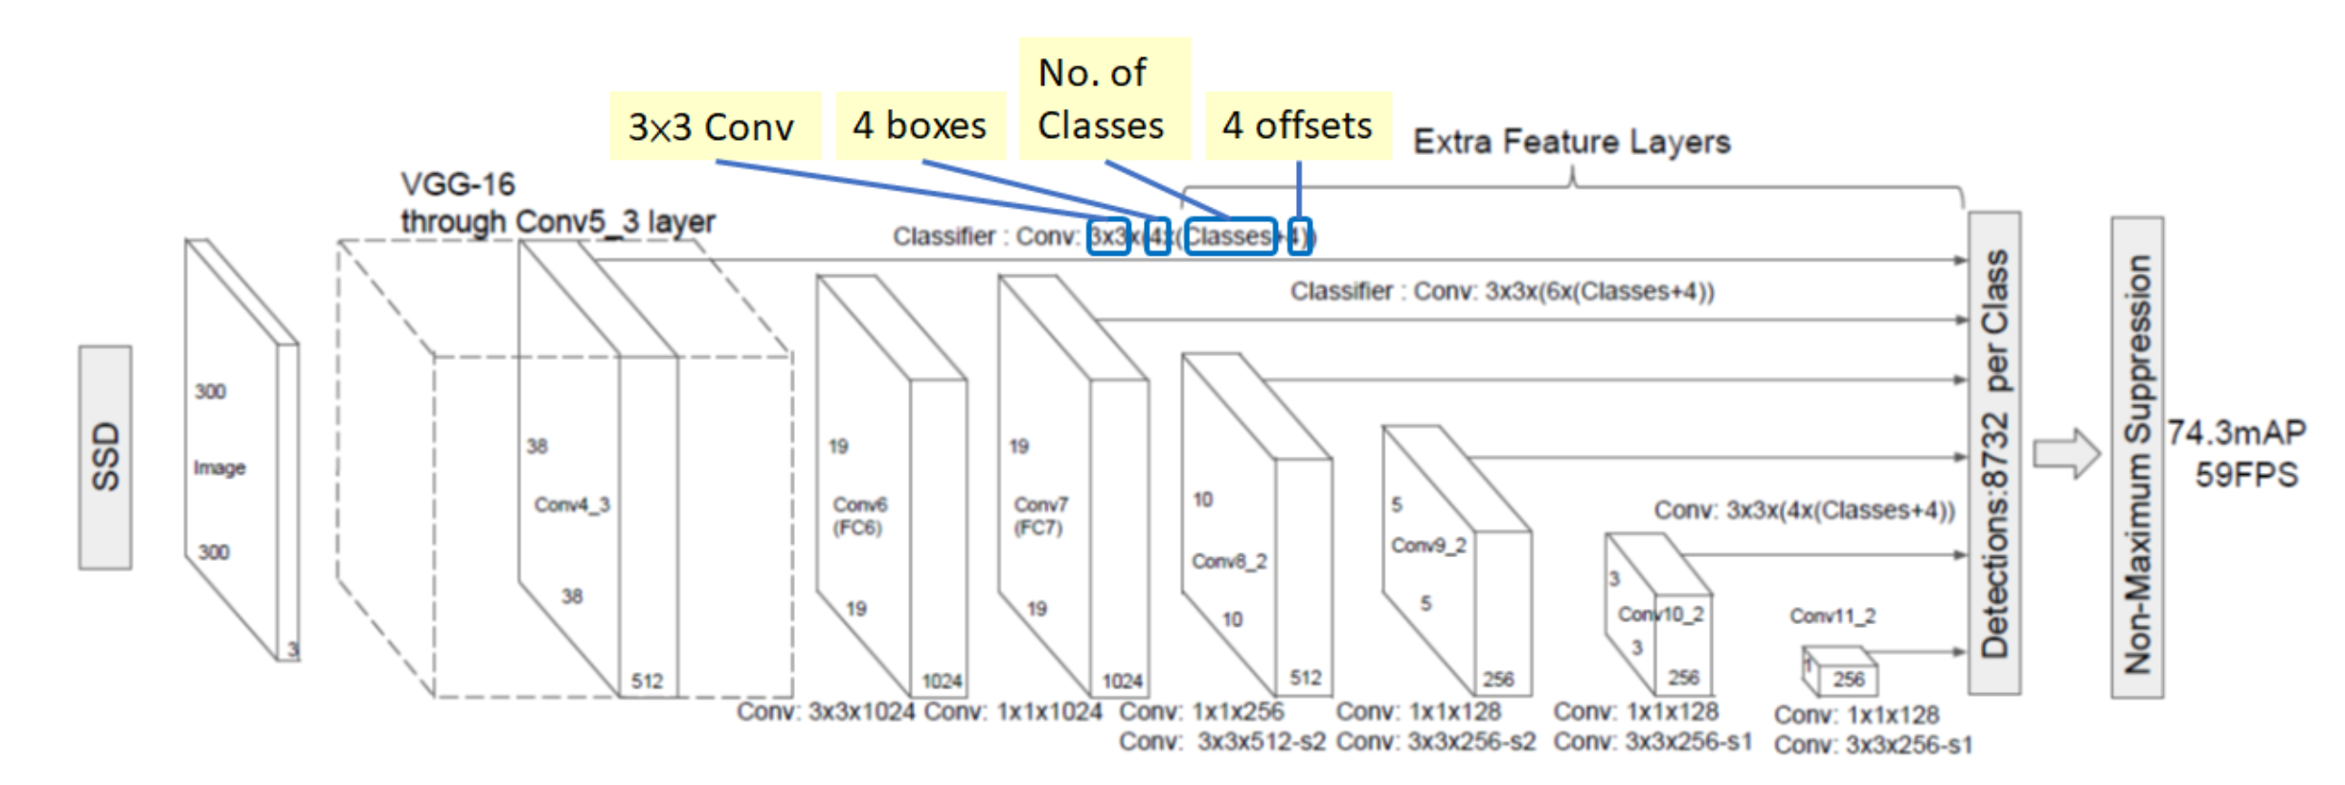
Network Architecture

Slide 4
Architecture Explained
SSD consists of a VGG base layer network.
Some other extra feature layers are added to make the classification of high resolution images easier.

Slide 5
Goal
To change the base layer network from VGG to TP NET and GC NET
Evaluate the mAP, initially for two or three classes should be fine.
Compare the performance with the current state of the art results.

Slide 6
Resources
Starting Kernel code
https://github.com/lvaleriu/ssd_keras-1
Youtube Videos
https://www.youtube.com/watch?v=5rY7CevPkKM
https://www.youtube.com/watch?v=mpfZFyisKGA&t=324s

